Slide 1


 | Port Malabar Rifle & Pistol Club – IDPA Name: Bay:
SCENARIO: XXX
START POSITION: ZXXX |  | STRINGS SCORING TARGETS SCORED HITS START – STOP MUZZLE SAFE POINT CONCEALMENT | 1 15 round min, unlimited 7 threat, 3 nonthreat T1: 3 rounds Audible – Last Shot 180º Required
STAGE PROCEDURE: XXXX

Slide 2
Port Malabar Rifle & Pistol Club – IDPA
Stage Name: Bay: Stage Designer: Muzzle safe: Start-Stop: | Warehouse Blues 2 James Fort 180º Audible/Last Shot | Strings: Scoring: Targets: Round count: Scored Hits: Concealment: |  | 1 Unlimited 9 16 Best 2 per paper, Steel must fall Required
Scenario
Retuning From Lunch You Find That Your Warehouse Has Been Overrun By Looters And Are Threating Your Staff Take Action to Save Your Employees
Start Position
START POSITION: Gun loaded, holstered, and concealed; standing at SP with both feet touching the Start Stick.
Stage Procedure |  | Notes | Notes
At signal

Slide 3
MOVERS
Clamshell:
non-threat in front.
Clamshell:
non-threat in front.

Slide 4
MOVERS
Out & Back NS
Out & Back Target
Drop Out Shoot
Drop Out Shoot
Drop Out Penalty
Pull up:
Pull up:
Flop-Up
Flop-Up
Flop-Up
Flop-Up
Plate Flop-Up
Plate Flop-Up

Slide 5


Clam shell
(1 no-shoot)
Pull up:
Out and Back
Out and Back
Out and Back
Out and Back
Out and Back
Out and Back
Out and Back
Clamshell:
non-threat in front.

Slide 6
steel
steel
T-Shirt

Slide 7
SP
SP
SP
SP
3 yd
3 yd
3 yd
3 yd
5 yd
5 yd
5 yd
5 yd
7 yd
7 yd
7 yd
7 yd
10 yd
10 yd
10 yd
10 yd
15 yd
15 yd
15 yd
15 yd
18 yd
18 yd
18 yd
18 yd
T1
S1
PP1
PoC 1
PoC
T2
S2
PP2
PoC 2
PoC
T3
S3
PP3
PoC 3
PoC
T4
S4
PP4
PoC 4
PoC
T5
PoC
T6
PoC 5
PoC
T7
PoC 6
PoC
T8
T9
T10

Slide 8
Vision
Barrier
Vision
Barrier
Vision
Barrier
Vision
Barrier

Slide 9

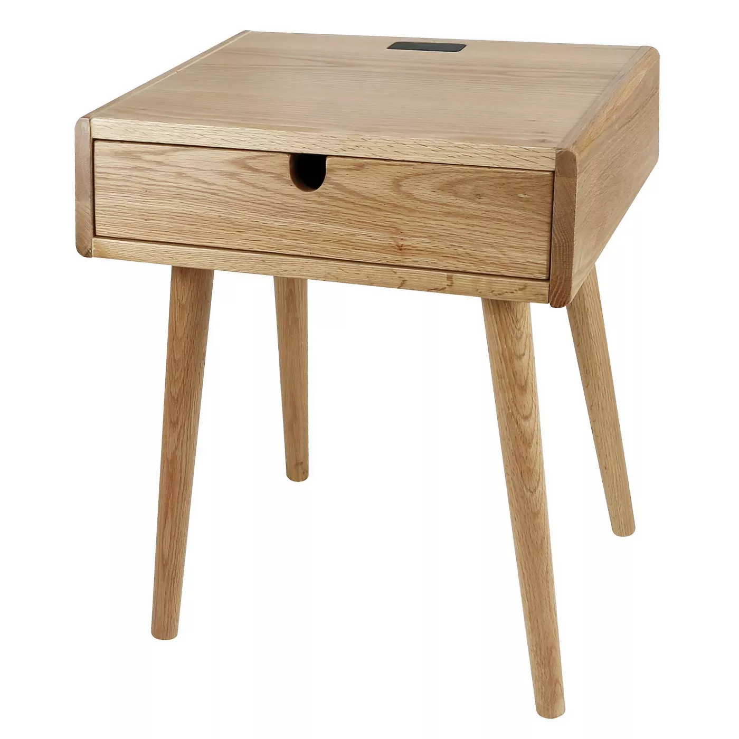
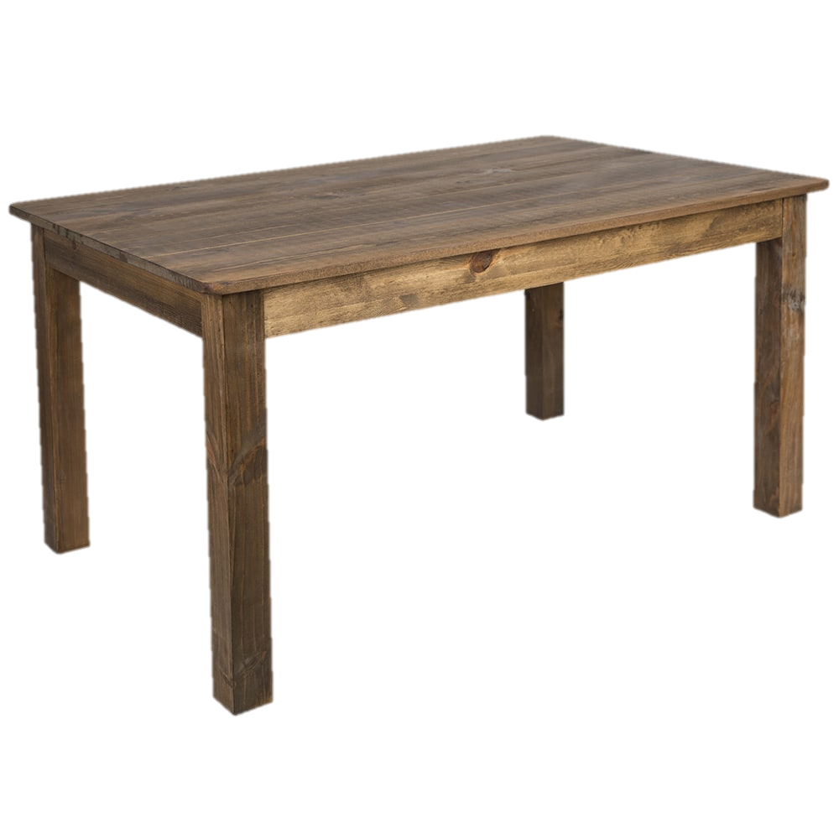

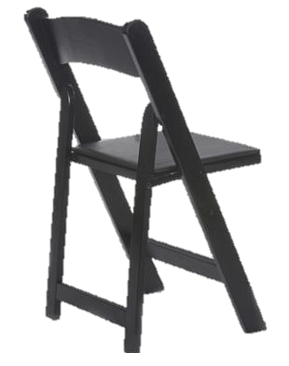
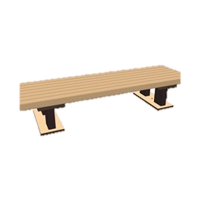
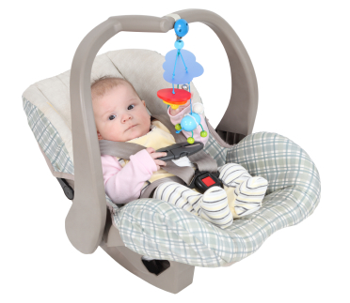

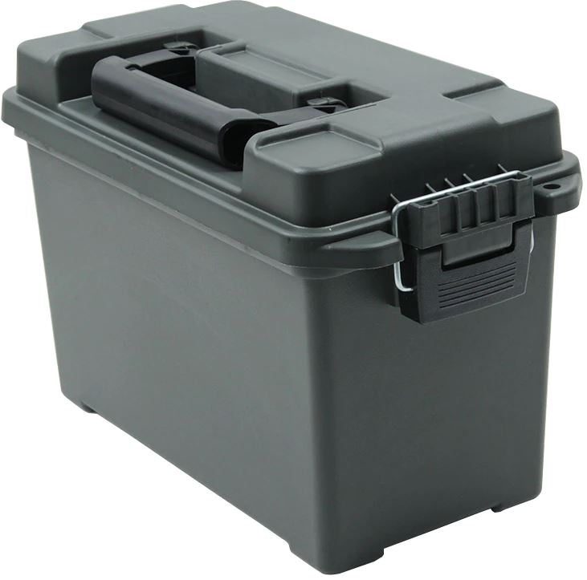
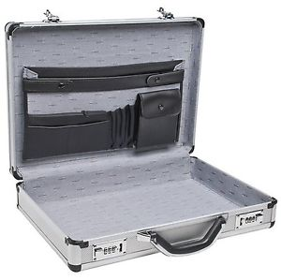

P3
Floating sidewalk
Step pad
STOMP Box
Badge Scanner

Slide 11




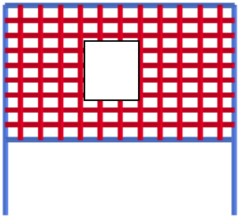

Slide 12
Walls with see-thru ports
PORT COVER, copy and paste to cover or change size of see-thru ports
Ungroup this wall, then click above, below, left or right of the port and resize the opening, then group the object again.

Slide 13
Walls with see-thru doorways & removable doors
Copy and paste, resize or edit points of this panel to cover or change a see thru doorway.
Doors- copy and paste these to make a door wall.

Slide 14


